Slide 1
Year 6 - Parents Meeting
Class Teacher: Miss Chadwick
Teaching Assistant: Mrs Bradley
Booster Sessions: Mrs Constable

Slide 2
Overview
Subject outline for the year
School expectations
Reading and Homework
SATS
Camp
Questions

Slide 3
Subjects | Term 1 | Term 2 | Term 3 | Term 4 | Term 5 | Term 6
English | “The Explorer” by Katherine Rundell diary, setting, description and narrative writing |  | The British Empire | Rosa Parks and Martin Luther King and the Windrush | Focus upon a variety of genres eg: poetry, fiction and instructions
Maths | Place value The 4 operations | Fractions | Decimals, percentages and algebra | Measurements, perimeter and area | Shape and problem solving | Maths investigations
Science | Light | Electricity | Evolution and Inheritance | Living things and their habitats
Geography/ History | Identify continents and oceans, use of compass points and a focus upon North and South America |  | Slavery to independence and American civil rights movement Windrush

Slide 4
School Expectations
To arrive on time to school
STAR
Carful Contributing
Wonderful Walking
Be Safe, Be Ready and Be Respectful
Using their manners
Listen when others are talking
Follow directions
Be kind and help others
Always try your best

Slide 5
Reading at home
10 minutes daily
Reading stars – certificates, book marks and books
Reading together and book talk
Summarise what has happened, make predictions, discuss the front cover and check understanding of vocabulary.
Encourage reading choices

Slide 6
Homework
Given out on a Wednesday due back in on a Monday
English, Maths, Spelling, Reading and TTRS
Reminders and support

Slide 7
Medication – Inhalers (need to be in school)
PE days – Tuesday and Friday

Slide 8
SATS
Monday 12th May 2025 | Grammar, Punctuation & Spelling - Paper 1 Grammar, Punctuation & Spelling - Paper 2
Tuesday 13th May 2025 | English Reading
Wednesday 14th May 2025 | Maths Paper 1 (Arithmetic) Maths Paper 2 (Reasoning)
Thursday 15th May 2024 | Maths Paper 3 (Reasoning)
Monday 12th May until Thursday 15th May
They assess your child’s strengths and where support can be provided
Practice SATS papers in school
Modelling of an English and Maths paper
Maths and English Interventions during school time
Any support with reading, spellings and timetables would be greatly appreciated.
Homework will include practice SATS questions
During half terms a pack with be provided with practice questions
The more relaxed you are, the more relaxed your child will be, which means they are likely to perform better during SATs week.
There is no writing test – evidence is collected throughout Year 6.

Slide 9
Specific arrangements
Additional (extra) time;
An adult to scribe (write) for them;
Using word processors independently;
An adult to read for them (including a translator);
The use of prompts or rest breaks

Slide 10

Spelling and Grammar Paper 1 and 2
Paper 1 is 45 minutes (Grammar and Punctuation)
This test focuses on:
Grammatical terms/ word classes;
Functions of sentences;
Combining words, phrases and clauses;
Verb forms, tenses and consistency;
Punctuation;
Vocabulary;
Standard English and formality.
This test requires a range of answer types but does not require longer formal answers. Eg: multiple choice, complete the sentence and rewrite the sentence questions
Paper 2 is 15 minutes (Spelling)
Focuses on spelling

Slide 11
Reading
60 minutes
There are three different set texts for children to read. These could be any combination of non-fiction, fiction and/ or poetry.
The test covers the following areas (known as Content Domains):
Give/ explain the meaning of words
Retrieve and record information/ identify key details
Summarise main ideas from more than one paragraph;
Make inferences from the text/ explain and justify inferences with evidence from the text;
Predict what might happen from details stated and implied;
Identify/ explain how information/ narrative content is related and contributes to meaning as a whole;
Identify/ explain how meaning is enhanced through choice of words and phrases;
Make comparisons within the text.
Questions include:
Multiple choice questions
One-word answers
Short answer questions
Multiple mark (long answer) questions

Slide 12
Maths
Paper 2 (reasoning) – 40 minutes
Paper 3 (reasoning) – 40 minutes
These papers require children to demonstrate their mathematical knowledge and skills, as well as their ability to solve problems and their mathematical reasoning. They cover a wide range of mathematical topics from key stage 2 including,
Number and place value (including Roman numerals);
The four operations;
Geometry (properties of shape, position and direction);
Statistics;
Measurement (length, perimeter, mass, volume, time, money);
Algebra;
Ratio and proportion;
Fractions, decimals and percentages.
Paper 1 (arithmetic) – 30 minutes
The test covers the four operations (addition, subtraction, multiplication, division, including order of operations requiring BIDMAS), percentages of amounts and calculating with decimals and fractions.

Slide 13
Scaled scores
Range from 80 to 120
100 shows pupils have met the National Standard
Tips:
Don’t use past papers as they are used in school to prepare the children.
Talk to myself if you have any concerns.
Encourage your child to talk to their teacher or a trusted adult (including yourself) about their anxieties.
Give your child a quiet, distraction free space to complete homework or study.
Give your child time to go outside.
Ensure your child is eating and drinking well and getting a good amount of sleep.
Plan something nice and fun for the weekends before and after SATs. This will help them to relax before the SATs and give them something to look forward to after.

Slide 14
Secondary School Applications
Applications open 12th September - they can be made online.
31st October Applications for Secondary schools close
3rd March – National Offer Day

Slide 15

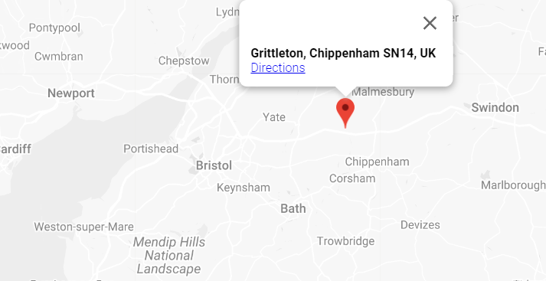
Camp – Grittleton Adventures
Monday 14th October – Thursday 17th October

Slide 16
Camp – Grittleton Adventures
Please return a completed medical form to school by Wednesday 11th September.
FSM Packed Lunches for Monday 14th October
Mobile phones or any electronic devices e.g. cameras are prohibited.
Photos will be taken and shared with yourselves once we have returned.
Please ensure your approval for this has been given.

Slide 17
Camp – Grittleton Adventures
Kit List Suggestions
Tracksuit bottoms (NOT jeans)
Fleece top/sweatshirts
Long and short sleeve t-shirts
Old trainers/outdoor shoes/indoor shoes/slippers
Toiletries/hair bands/brush
Bin bag for dirty clothes
Prescribed medication in a named bag and handed to staff on departure day
Underwear/nightwear/dressing gown
Water bottle

Slide 18
Camp – Grittleton Adventures
Helpful Hints:
•Please get children to pack their own bags. This will help them when they have to re-pack for the journey home.
•Practise making a bed! Room inspections will take place!
•Please bring a small rucksack for use on the coach, and when on activities.
•Children must be able to carry their own bags!
•Please pack a couple of labelled bin bags for muddy clothes.
•Please label everything.
•Your children will have a great time! The staff will have a great time!
•You must have a good time without them!
•We will look after them!

Slide 19
Questions…

