Slide 1
Walk to School Month May 2024

Slide 2
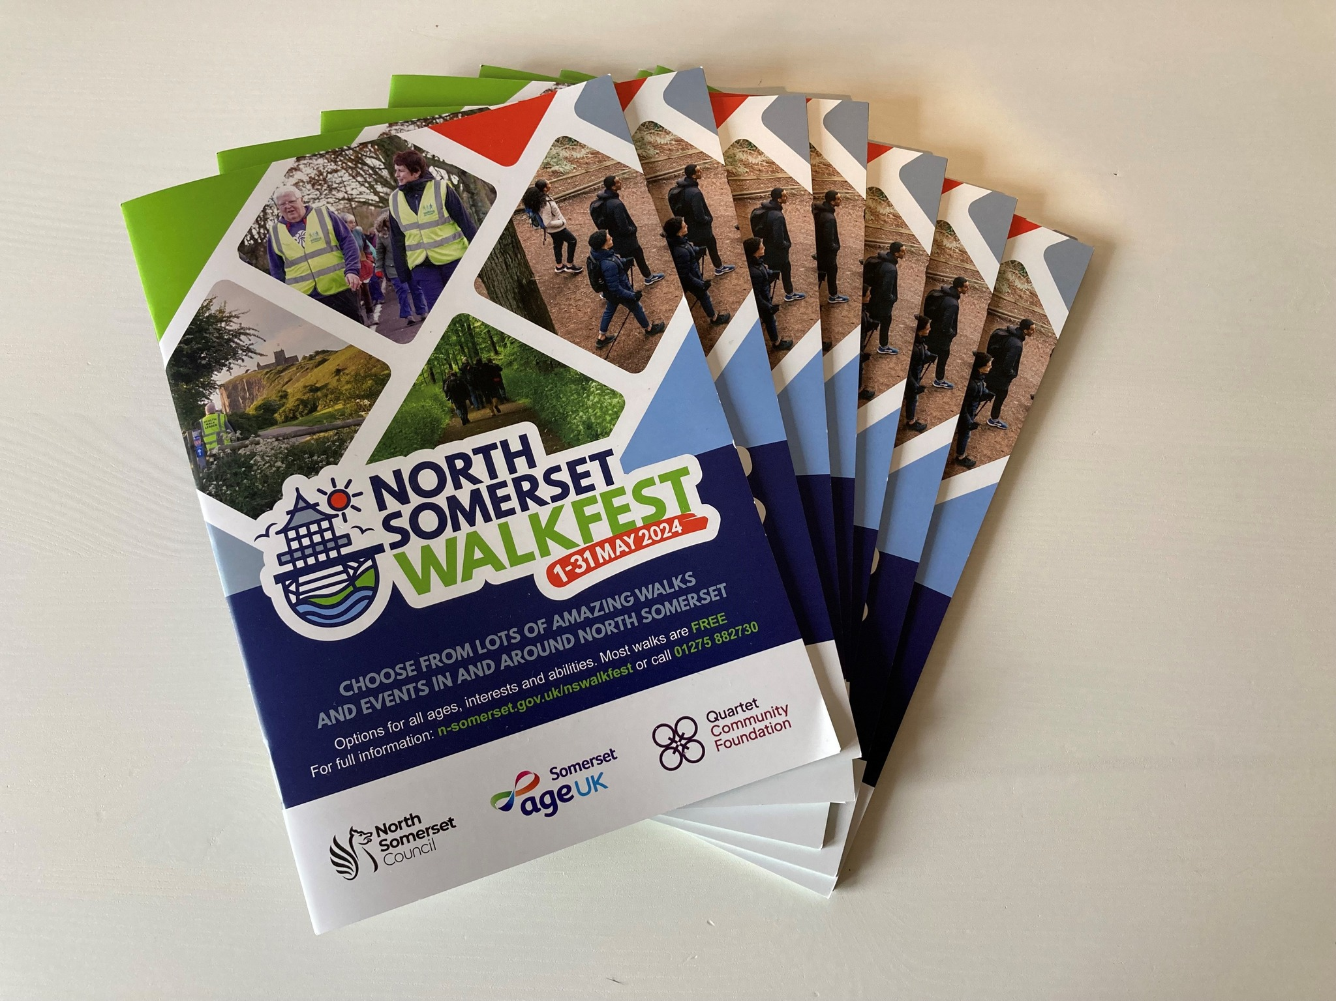
North Somerset Walking Festival May 2024
People of all ages across North Somerset are being encouraged to take part in a brand new walking festival taking place during May for National Walking Month.
Cllr Jenna Ho Marris, North Somerset Council’s executive member for public health, said:
“Walking is such a great way to improve your physical and mental health. It’s a simple, free way of being more active and ideal for people of all ages and fitness levels.”

Slide 3
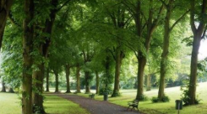
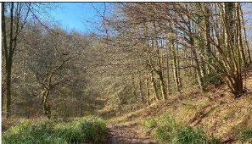
Exciting family walks to go on in North Somerset
https://www.betterhealthns.co.uk/wp-content/uploads/2022/06/walking-routes-table-2.pdf
During North Somerset Walk Fest in May, we are challenging you to Walk Every Day in May.
Walk on the beach
Walk to school
This can be however long or short you like. We want everyone to feel the benefits of being active and getting outside. Tick off the days you walk, or you could write how long or far you walked and try to improve throughout the month, a little at a time.
Walk with your family
Go to the park
Take your pet for a walk
Walk to the shops
Park and stride to school

Slide 4
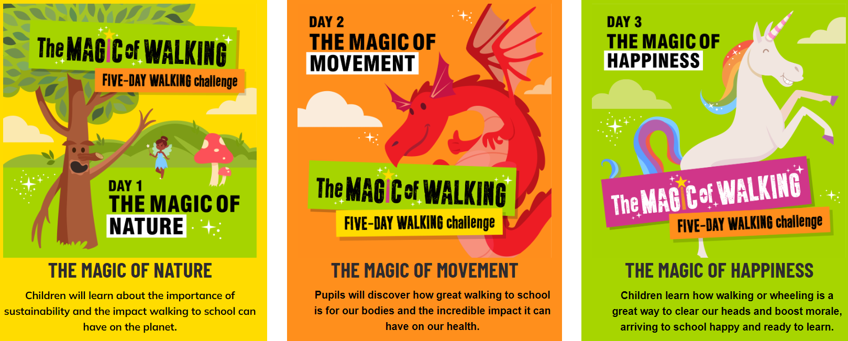
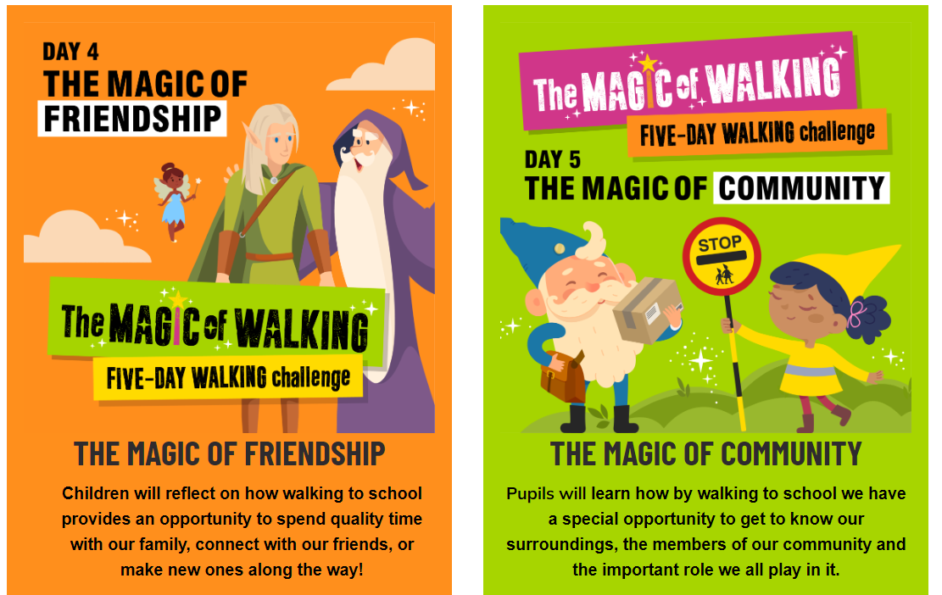
Walk to School Week – 20th May 2024

Slide 5
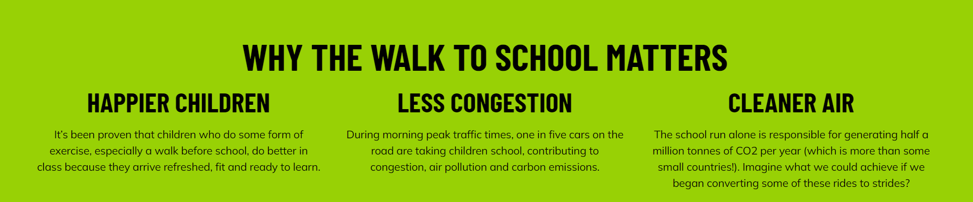
Walk to School Week – 20th May 2024

Slide 6
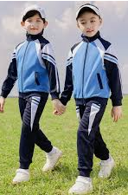
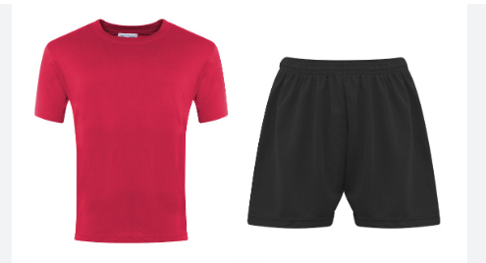
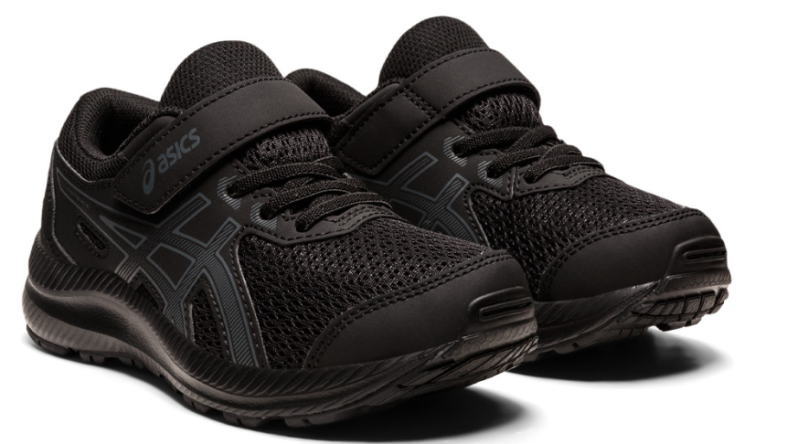
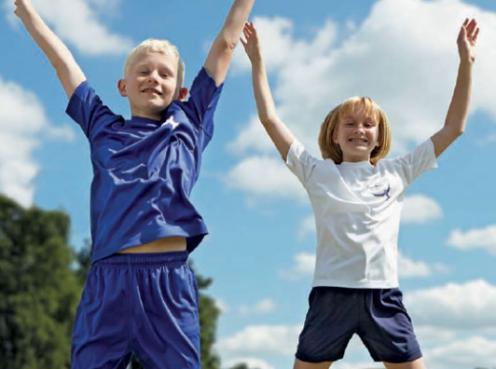
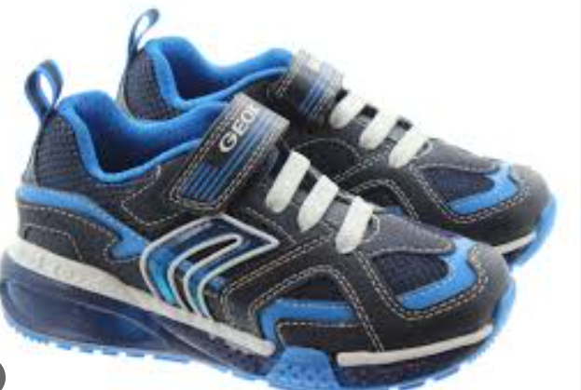
Active Wear Day
To encourage Walking to School during May, which is National Walking Month, we are going to have an ‘Active Wear Day’ on Tuesday 7th May 2024.
On this day you can wear trainers, joggers, t-shirts, leggings, football kits…
…so that you have comfortable footwear for walking to school.
If you live a little further away, remember you can ‘park and stride.’
Let’s aim for 100% active travel.
£1 donation to raise money for a
friendship bench

Slide 7
Reflections
Walking helps us to look after our health and care for our bodies and minds. Caring for our bodies and minds is a way for many people to show respect for themselves and help themselves to relax and enjoy life.
Walking outside can connect us with the natural world. We spot trees, birds, flowers and so on. For many people, that enables them to reflect upon the beauty of our world.

Slide 8
North Somerset Walking Festival – ideas for families
https://n-somerset.gov.uk/news/get-ready-walk-may-when-north-somerset-walk-fest-launches-next-month?mc_cid=6fcce8c18e&mc_eid=23888ad4bc
https://www.betterhealthns.co.uk/information/where-to-walk-in-north-somerset/
https://www.betterhealthns.co.uk/wp-content/uploads/2022/06/walking-routes-table-2.pdf
https://www.betterhealthns.co.uk/wp-content/uploads/2023/04/Walk-Every-Day-in-May-24-colour.pdf

